Slide 1
Chapter:5 Transactions Concurrency control Phase Control Protocol Log Based Recovery DeadLock Two phase Locking Protocol

Slide 2
Transaction Concept
A transaction is a unit of program execution that accesses and possibly updates various data items.
E.g., transaction to transfer $50 from account A to account B:
1. read(A)
2. A := A – 50
3. write(A)
4. read(B)
5. B := B + 50
6. write(B)
Two main issues to deal with:
Failures of various kinds, such as hardware failures and system crashes
Concurrent execution of multiple transactions

Slide 3
Required Properties of a Transaction
Consider a transaction to transfer $50 from account A to account B:
1. read(A)
2. A := A – 50
3. write(A)
4. read(B)
5. B := B + 50
6. write(B)
Atomicity requirement
If the transaction fails after step 3 and before step 6, money will be “lost” leading to an inconsistent database state
Failure could be due to software or hardware
The system should ensure that updates of a partially executed transaction are not reflected in the database
Durability requirement — once the user has been notified that the transaction has completed (i.e., the transfer of the $50 has taken place), the updates to the database by the transaction must persist even if there are software or hardware failures.

Slide 4
Required Properties of a Transaction (Cont.)
Consistency requirement in above example:
The sum of A and B is unchanged by the execution of the transaction
In general, consistency requirements include
Explicitly specified integrity constraints such as primary keys and foreign keys
Implicit integrity constraints
e.g., sum of balances of all accounts, minus sum of loan amounts must equal value of cash-in-hand
A transaction, when starting to execute, must see a consistent database.
During transaction execution the database may be temporarily inconsistent.
When the transaction completes successfully the database must be consistent
Erroneous transaction logic can lead to inconsistency

Slide 5
Required Properties of a Transaction (Cont.)
Isolation requirement — if between steps 3 and 6 (of the fund transfer transaction) , another transaction T2 is allowed to access the partially updated database, it will see an inconsistent database (the sum A + B will be less than it should be).
T1 T2
1. read(A)
2. A := A – 50
3. write(A) read(A), read(B), print(A+B)
4. read(B)
5. B := B + 50
6. write(B
Isolation can be ensured trivially by running transactions serially
That is, one after the other.
However, executing multiple transactions concurrently has significant benefits, as we will see later.

Slide 6
ACID Properties
A transaction is a unit of program execution that accesses and possibly updates various data items. To preserve the integrity of data the database system must ensure:
Atomicity. Either all operations of the transaction are properly reflected in the database or none are.
Consistency. Execution of a transaction in isolation preserves the consistency of the database.
Isolation. Although multiple transactions may execute concurrently, each transaction must be unaware of other concurrently executing transactions. Intermediate transaction results must be hidden from other concurrently executed transactions.
That is, for every pair of transactions T_{i} and T_{j}, it appears to T_{i} that either T_{j}, finished execution before T_{i} started, or T_{j} started execution after T_{i} finished.
Durability. After a transaction completes successfully, the changes it has made to the database persist, even if there are system failures.

Slide 7
Transaction State
Active – the initial state; the transaction stays in this state while it is executing
Partially committed – after the final statement has been executed.
Failed -- after the discovery that normal execution can no longer proceed.
Aborted – after the transaction has been rolled back and the database restored to its state prior to the start of the transaction. Two options after it has been aborted:
Restart the transaction
can be done only if no internal logical error
Kill the transaction
Committed – after successful completion.

Slide 8
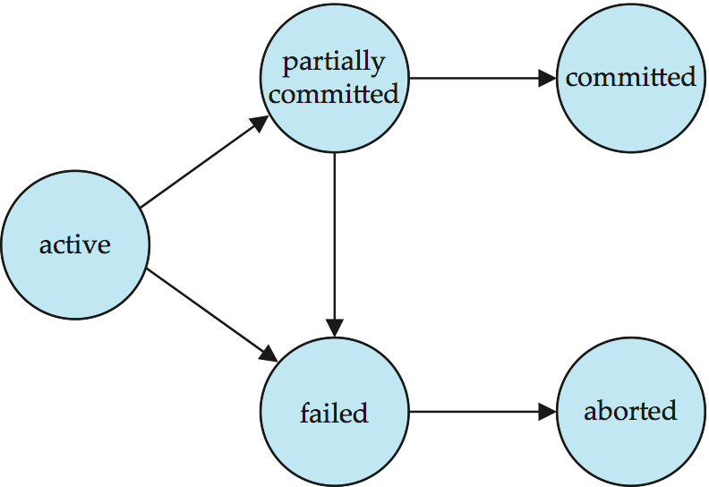
Transaction State (Cont.)

Slide 9
Concurrent Executions
Multiple transactions are allowed to run concurrently in the system. Advantages are:
Increased processor and disk utilization, leading to better transaction throughput
E.g. one transaction can be using the CPU while another is reading from or writing to the disk
Reduced average response time for transactions: short transactions need not wait behind long ones.
Concurrency control schemes – mechanisms to achieve isolation
That is, to control the interaction among the concurrent transactions in order to prevent them from destroying the consistency of the database
Will study in Chapter 15, after studying notion of correctness of concurrent executions.

Slide 10
Schedules
Schedule – a sequences of instructions that specify the chronological order in which instructions of concurrent transactions are executed
A schedule for a set of transactions must consist of all instructions of those transactions
Must preserve the order in which the instructions appear in each individual transaction.
A transaction that successfully completes its execution will have a commit instructions as the last statement
By default transaction assumed to execute commit instruction as its last step
A transaction that fails to successfully complete its execution will have an abort instruction as the last statement

Slide 11
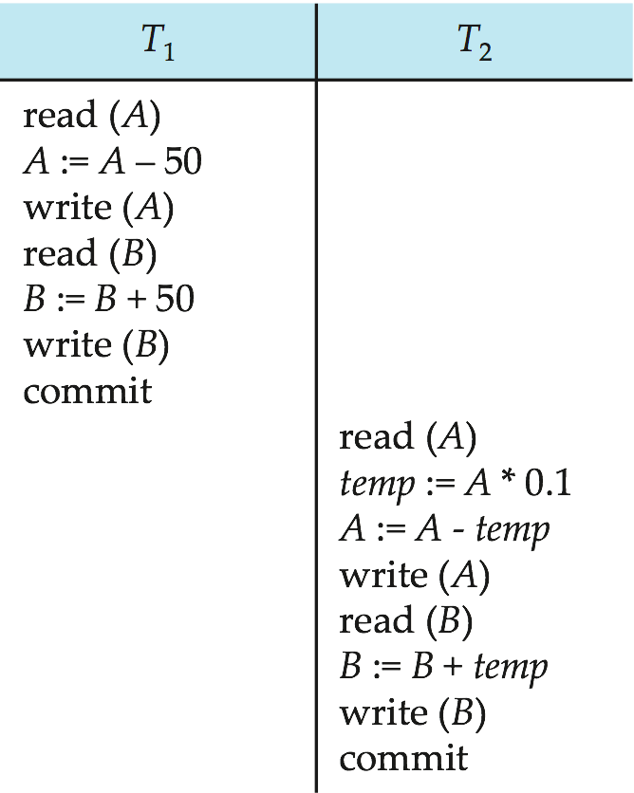
Schedule 1
Let T₁ transfer $50 from A to B, and T₂ transfer 10% of the balance from A to B.
An example of a serial schedule in which T₁ is followed by T₂ :

Slide 12
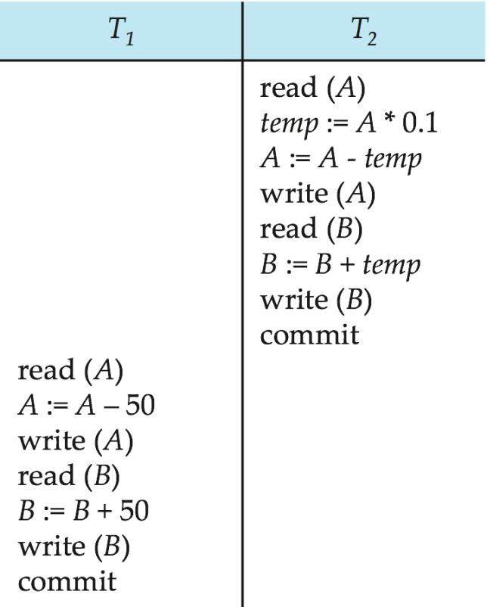
Schedule 2
A serial schedule in which T₂ is followed by T₁ :

Slide 13
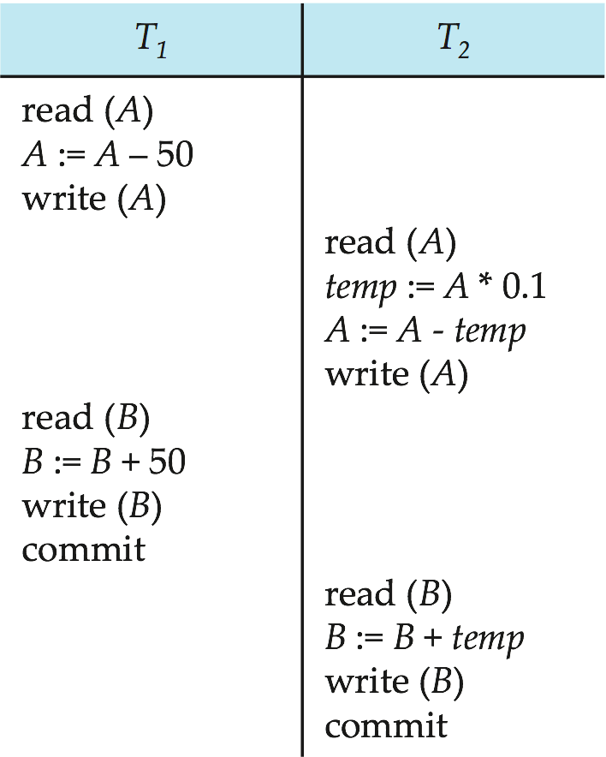
Schedule 3
Let T₁ and T₂ be the transactions defined previously. The following schedule is not a serial schedule, but it is equivalent to Schedule 1.
Note -- In schedules 1, 2 and 3, the sum “A + B” is preserved.

Slide 14
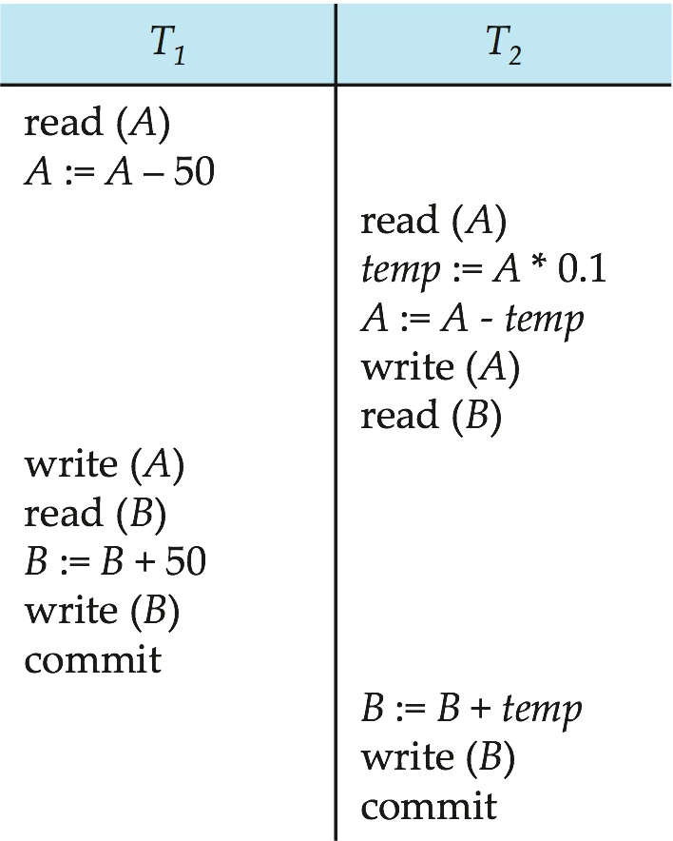
Schedule 4
The following concurrent schedule does not preserve the sum of “A + B”

Slide 15
Concurrency Control and Recovery
With concurrent transactions, all transactions share a single disk buffer and a single log
A buffer block can have data items updated by one or more transactions
We assume that if a transaction T_{i} has modified an item, no other transaction can modify the same item until T_{i} has committed or aborted
i.e. the updates of uncommitted transactions should not be visible to other transactions
Otherwise how to perform undo if T1 updates A, then T2 updates A and commits, and finally T1 has to abort?
Can be ensured by obtaining exclusive locks on updated items and holding the locks till end of transaction (strict two-phase locking)
Log records of different transactions may be interspersed in the log.

Slide 16
Undo and Redo Operations
Undo of a log record <T_{i}, X, V₁, V₂> writes the old value V₁ to X
Redo of a log record <T_{i}, X, V₁, V₂> writes the new value V₂ to X
Undo and Redo of Transactions
undo(T_{i}) restores the value of all data items updated by T_{i} to their old values, going backwards from the last log record for T_{i}
each time a data item X is restored to its old value V a special log record <T_{i} , X, V> is written out
when undo of a transaction is complete, a log record <T_{i} abort> is written out.
redo(T_{i}) sets the value of all data items updated by T_{i} to the new values, going forward from the first log record for T_{i}
No logging is done in this case

Slide 17
Undo and Redo on Recovering from Failure
When recovering after failure:
Transaction T_{i} needs to be undone if the log
contains the record <T_{i} start>,
but does not contain either the record <T_{i} commit> or <T_{i} abort>.
Transaction T_{i} needs to be redone if the log
contains the records <T_{i} start>
and contains the record <T_{i} commit> or <T_{i} abort>
Note that If transaction T_{i} was undone earlier and the <T_{i} abort> record written to the log, and then a failure occurs, on recovery from failure T_{i} is redone
such a redo redoes all the original actions including the steps that restored old values
Known as repeating history
Seems wasteful, but simplifies recovery greatly

Slide 18
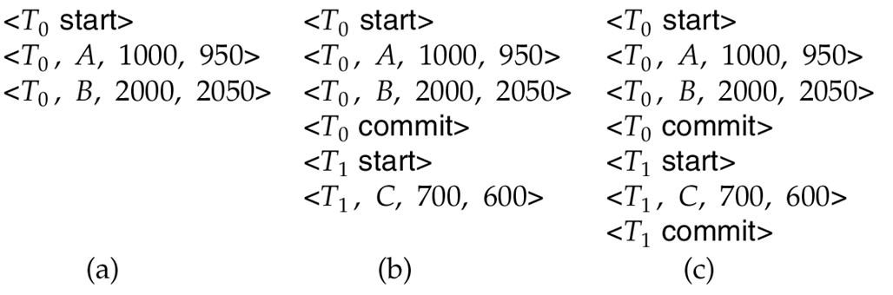
Immediate DB Modification Recovery Example
Below we show the log as it appears at three instances of time.
Recovery actions in each case above are:
(a) undo (T₀): B is restored to 2000 and A to 1000, and log records <T₀, B, 2000>, <T₀, A, 1000>, <T₀, abort> are written out
(b) redo (T₀) and undo (T₁): A and B are set to 950 and 2050 and C is restored to 700. Log records <T₁, C, 700>, <T₁, abort> are written out.
(c) redo (T₀) and redo (T₁): A and B are set to 950 and 2050
respectively. Then C is set to 600

Slide 19
Concurrency Control
controlling concurrent execution of the operations
Concurrent Execution in DBMS:
same database is executed simultaneously on a multi-user system by different users.
using the database by multiple users for performing different operations.
on making the concurrent execution of the transaction operations, there occur several challenging problems that need to be solved.

Slide 20
Problems with Concurrent Execution:
Problem 1: Lost Update Problems (W - W Conflict)
The problem occurs when two different database transactions perform the read/write operations on the same database items in an interleaved manner (i.e., concurrent execution) that makes the values of the items incorrect hence making the database inconsistent.

Slide 21
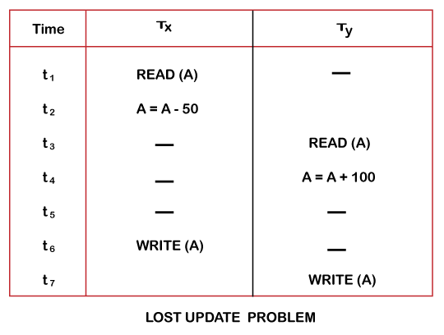

Slide 22
At time t1, transaction T_{X} reads the value of account A, i.e., $300 (only read).
At time t2, transaction T_{X} deducts $50 from account A that becomes $250 (only deducted and not updated/write).
Alternately, at time t3, transaction T_{Y} reads the value of account A that will be $300 only because T_{X} didn't update the value yet.
At time t4, transaction T_{Y} adds $100 to account A that becomes $400 (only added but not updated/write).
At time t6, transaction T_{X} writes the value of account A that will be updated as $250 only, as T_{Y} didn't update the value yet.
Similarly, at time t7, transaction T_{Y} writes the values of account A, so it will write as done at time t4 that will be $400. It means the value written by T_{X} is lost, i.e., $250 is lost.

Slide 23
Dirty Read Problems (W-R Conflict)
The dirty read problem occurs when one transaction updates an item of the database, and somehow the transaction fails, and before the data gets rollback, the updated database item is accessed by another transaction. There comes the Read-Write Conflict between both transactions.

Slide 24
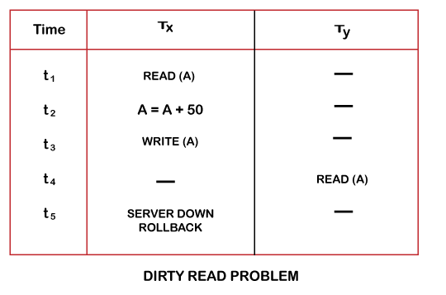

Slide 25
At time t1, transaction T_{X} reads the value of account A, i.e., $300.
At time t2, transaction T_{X} adds $50 to account A that becomes $350.
At time t3, transaction T_{X} writes the updated value in account A, i.e., $350.
Then at time t4, transaction T_{Y} reads account A that will be read as $350.
Then at time t5, transaction T_{X} rollbacks due to server problem, and the value changes back to $300 (as initially).
But the value for account A remains $350 for transaction T_{Y} as committed, which is the dirty read and therefore known as the Dirty Read Problem.

Slide 26
Unrepeatable Read Problem (W-R Conflict):
Also known as Inconsistent Retrievals Problem that occurs when in a transaction, two different values are read for the same database item.

Slide 28
At time t1, transaction T_{X} reads the value from account A, i.e., $300.
At time t2, transaction T_{Y} reads the value from account A, i.e., $300.
At time t3, transaction T_{Y} updates the value of account A by adding $100 to the available balance, and then it becomes $400.
At time t4, transaction T_{Y} writes the updated value, i.e., $400.
After that, at time t5, transaction T_{X} reads the available value of account A, and that will be read as $400.
It means that within the same transaction T_{X}, it reads two different values of account A, i.e., $ 300 initially, and after updation made by transaction T_{Y}, it reads $400. It is an unrepeatable read and is therefore known as the Unrepeatable read problem.

Slide 29
Thus, in order to maintain consistency in the database and avoid such problems that take place in concurrent execution, management is needed, and that is where the concept of Concurrency Control comes into role.
Concurrency Control
Concurrency Control is the working concept that is required for controlling and managing the concurrent execution of database operations and thus avoiding the inconsistencies in the database. Thus, for maintaining the concurrency of the database, we have the concurrency control protocols.
Concurrency Control Protocols:
The concurrency control protocols ensure the atomicity, consistency, isolation, durability and serializability of the concurrent execution of the database transactions. Therefore, these protocols are categorized as:
Lock Based Concurrency Control Protocol
Time Stamp Concurrency Control Protocol
Validation Based Concurrency Control Protocol

Slide 30
Lock-Based Protocols
A lock is a mechanism to control concurrent access to a data item
Data items can be locked in two modes :
1. exclusive (X) mode. Data item can be both read as well as
written. X-lock is requested using lock-X instruction.
2. shared (S) mode. Data item can only be read. S-lock is
requested using lock-S instruction.
Lock requests are made to the concurrency-control manager by the programmer. Transaction can proceed only after request is granted.

Slide 31
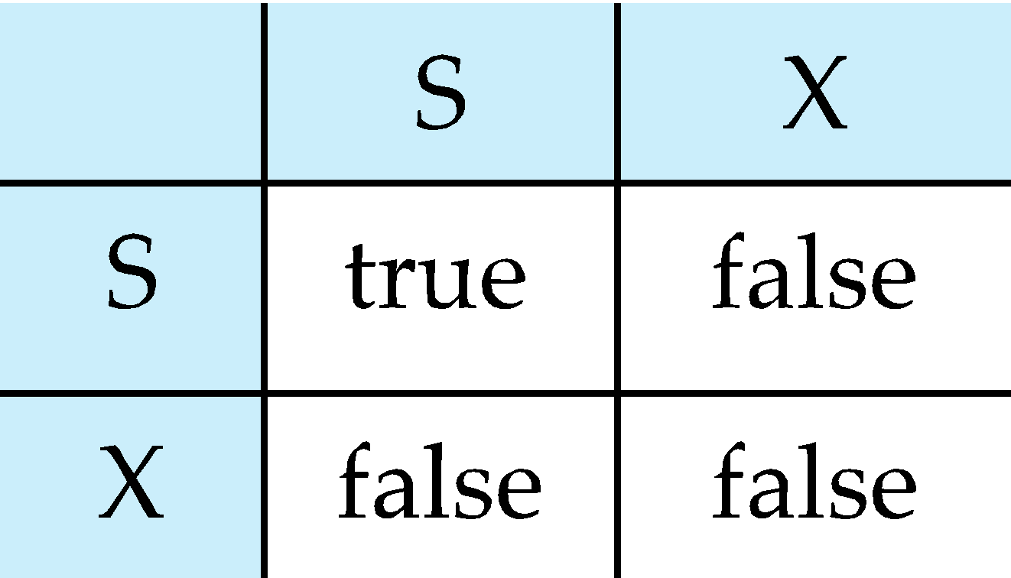
Lock-Based Protocols (Cont.)
Lock-compatibility matrix
A transaction may be granted a lock on an item if the requested lock is compatible with locks already held on the item by other transactions
Any number of transactions can hold shared locks on an item,
But if any transaction holds an exclusive on the item no other transaction may hold any lock on the item.
If a lock cannot be granted, the requesting transaction is made to wait till all incompatible locks held by other transactions have been released. The lock is then granted.

Slide 32
Lock-Based Protocols (Cont.)
Example of a transaction performing locking:
T₂: lock-S(A);
read (A);
unlock(A);
lock-S(B);
read (B);
unlock(B);
display(A+B)
Locking as above is not sufficient to guarantee serializability — if A and B get updated in-between the read of A and B, the displayed sum would be wrong.
A locking protocol is a set of rules followed by all transactions while requesting and releasing locks. Locking protocols restrict the set of possible schedules.

Slide 33
The Two-Phase Locking Protocol
This protocol ensures conflict-serializable schedules.
Phase 1: Growing Phase
Transaction may obtain locks
Transaction may not release locks
Phase 2: Shrinking Phase
Transaction may release locks
Transaction may not obtain locks
The protocol assures serializability. It can be proved that the transactions can be serialized in the order of their lock points (i.e., the point where a transaction acquired its final lock).

Slide 34
The Two-Phase Locking Protocol (Cont.)
There can be conflict serializable schedules that cannot be obtained if two-phase locking is used.
However, in the absence of extra information (e.g., ordering of access to data), two-phase locking is needed for conflict serializability in the following sense:
Given a transaction T_{i} that does not follow two-phase locking, we can find a transaction T_{j} that uses two-phase locking, and a schedule for T_{i} and T_{j} that is not conflict serializable.

Slide 35
Lock Conversions
Two-phase locking with lock conversions:
– First Phase:
can acquire a lock-S on item
can acquire a lock-X on item
can convert a lock-S to a lock-X (upgrade)
– Second Phase:
can release a lock-S
can release a lock-X
can convert a lock-X to a lock-S (downgrade)
This protocol assures serializability. But still relies on the programmer to insert the various locking instructions.

Slide 36
Automatic Acquisition of Locks
A transaction T_{i} issues the standard read/write instruction, without explicit locking calls.
The operation read(D) is processed as:
if T_{i} has a lock on D
then
read(D)
else begin
if necessary wait until no other
transaction has a lock-X on D
grant T_{i} a lock-S on D;
read(D)
end

Slide 37
Automatic Acquisition of Locks (Cont.)
write(D) is processed as:
if T_{i} has a lock-X on D
then
write(D)
else begin
if necessary wait until no other transaction has any lock on D,
if T_{i} has a lock-S on D
then
upgrade lock on D to lock-X
else
grant T_{i} a lock-X on D
write(D)
end;
All locks are released after commit or abort

Slide 38
Timestamp Ordering Protocol: used to order the transactions based on their Timestamps. ascending order of the transaction creation. The priority of the older transaction is higher that's why it executes first. To determine the timestamp of the transaction, this protocol uses system time or logical counter. Timestamp based protocols start working as soon as a transaction is created. Let's assume there are two transactions T1 and T2. Suppose the transaction T1 has entered the system at 007 times and transaction T2 has entered the system at 009 times. T1 has the higher priority, so it executes first as it is entered the system first. The timestamp ordering protocol also maintains the timestamp of last 'read' and 'write' operation on a data. Basic Timestamp ordering protocol works as follows:

Slide 39
1. Check the following condition whenever a transaction Ti issues a Read (X) operation: ->If W_TS(X) >TS(Ti) then the operation is rejected. ->If W_TS(X) <= TS(Ti) then the operation is executed. ->Timestamps of all the data items are updated. 2. Check the following condition whenever a transaction Ti issues a Write(X) operation: ->If TS(Ti) < R_TS(X) then the operation is rejected. ->If TS(Ti) < W_TS(X) then the operation is rejected and Ti is rolled back otherwise the operation is executed. Where, TS(TI) denotes the timestamp of the transaction Ti. R_TS(X) denotes the Read time-stamp of data-item X. W_TS(X) denotes the Write time-stamp of data-item X.

Slide 40
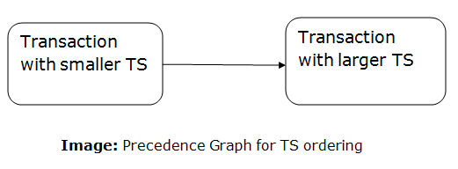
Advantages and Disadvantages of TO protocol: TO protocol ensures serializability since the precedence graph is as follows:

Slide 41
->TS protocol ensures freedom from deadlock that means no transaction ever waits. ->But the schedule may not be recoverable and may not even be cascade- free.

Slide 42
Validation Based Protocol: Validation phase is also known as optimistic concurrency control technique. In the validation based protocol, the transaction is executed in the following three phases: Read phase: In this phase, the transaction T is read and executed. It is used to read the value of various data items and stores them in temporary local variables. It can perform all the write operations on temporary variables without an update to the actual database. Validation phase: In this phase, the temporary variable value will be validated against the actual data to see if it violates the serializability. Write phase: If the validation of the transaction is validated, then the temporary results are written to the database or system otherwise the transaction is rolled back. Here each phase has the following different timestamps: Start(Ti): It contains the time when Ti started its execution. Validation (T_{i}): It contains the time when Ti finishes its read phase and starts its validation phase. Finish(Ti): It contains the time when Ti finishes its write phase.

Slide 43
This protocol is used to determine the time stamp for the transaction for serialization using the time stamp of the validation phase, as it is the actual phase which determines if the transaction will commit or rollback. Hence TS(T) = validation(T). The serializability is determined during the validation process. It can't be decided in advance. While executing the transaction, it ensures a greater degree of concurrency and also less number of conflicts. Thus it contains transactions which have less number of rollbacks.

Slide 44
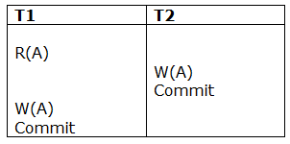
Thomas write Rule ->guarantee of serializability order for the protocol. -> improves the Basic Timestamp Ordering Algorithm. The basic Thomas write rules are as follows: If TS(T) < R_TS(X) then transaction T is aborted and rolled back, and operation is rejected. If TS(T) < W_TS(X) then don't execute the W_item(X) operation of the transaction and continue processing. If neither condition 1 nor condition 2 occurs, then allowed to execute the WRITE operation by transaction Ti and set W_TS(X) to TS(T). If we use the Thomas write rule then some serializable schedule can be permitted that does not conflict serializable as illustrate by the schedule in a given figure:
Figure: A Serializable Schedule that is not Conflict Serializable

Slide 45
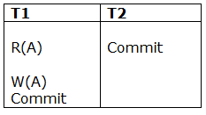
In the above figure, T1's read and precedes T1's write of the same data item. This schedule does not conflict serializable. Thomas write rule checks that T2's write is never seen by any transaction. If we delete the write operation in transaction T2, then conflict serializable schedule can be obtained which is shown in below figure.
Figure: A Conflict Serializable Schedule

Slide 46
Multiple Granularity
Allow data items to be of various sizes and define a hierarchy of data granularities, where the small granularities are nested within larger ones
Can be represented graphically as a tree.
When a transaction locks a node in the tree explicitly, it implicitly locks all the node's descendents in the same mode.
Granularity of locking (level in tree where locking is done):
fine granularity (lower in tree): high concurrency, high locking overhead
coarse granularity (higher in tree): low locking overhead, low concurrency

Slide 47
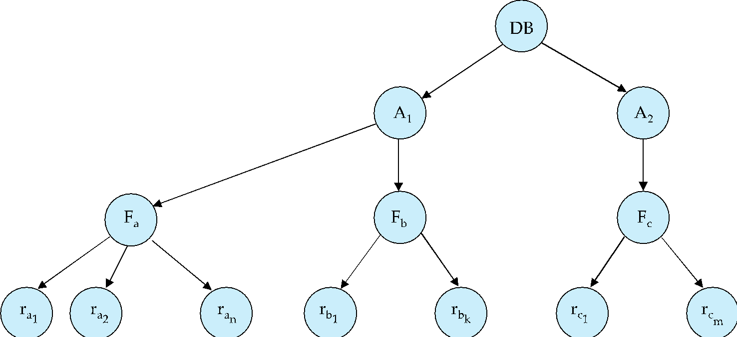
Example of Granularity Hierarchy
The levels, starting from the coarsest (top) level are
database
area
file
record

Slide 48
Intention Lock Modes
In addition to S and X lock modes, there are three additional lock modes with multiple granularity:
intention-shared (IS): indicates explicit locking at a lower level of the tree but only with shared locks.
intention-exclusive (IX): indicates explicit locking at a lower level with exclusive or shared locks
shared and intention-exclusive (SIX): the subtree rooted by that node is locked explicitly in shared mode and explicit locking is being done at a lower level with exclusive-mode locks.
intention locks allow a higher level node to be locked in S or X mode without having to check all descendent nodes.

Slide 49
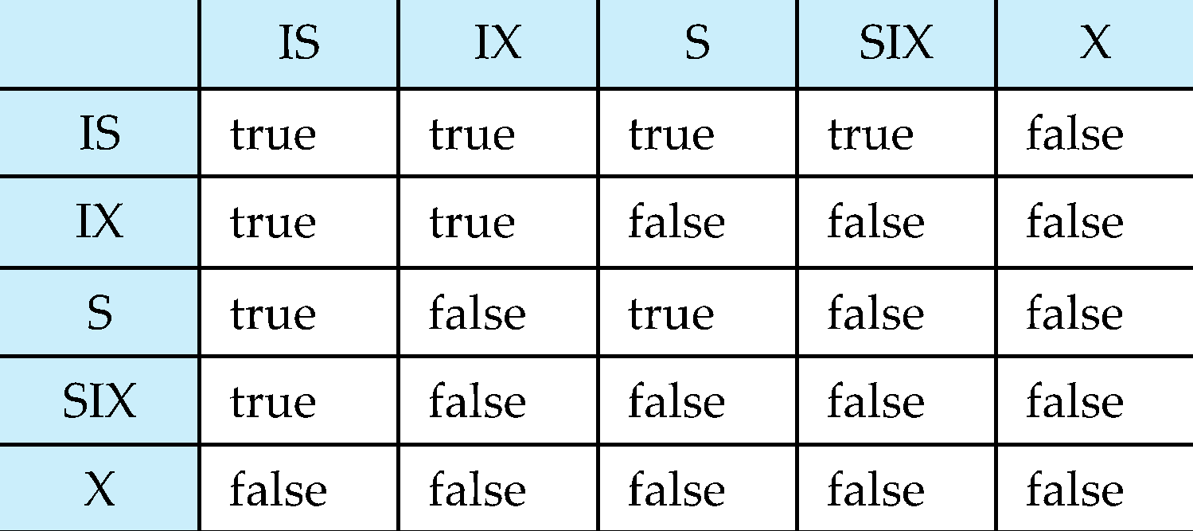
Compatibility Matrix with Intention Lock Modes
The compatibility matrix for all lock modes is:

Slide 50
Multiple Granularity Locking Scheme
Transaction T_{i} can lock a node Q, using the following rules:
The lock compatibility matrix must be observed.
The root of the tree must be locked first, and may be locked in any mode.
A node Q can be locked by T_{i} in S or IS mode only if the parent of Q is currently locked by T_{i} in either IX or IS mode.
A node Q can be locked by T_{i} in X, SIX, or IX mode only if the parent of Q is currently locked by T_{i} in either IX or SIX mode.
T_{i} can lock a node only if it has not previously unlocked any node (that is, T_{i} is two-phase).
T_{i} can unlock a node Q only if none of the children of Q are currently locked by T_{i}.
Observe that locks are acquired in root-to-leaf order, whereas they are released in leaf-to-root order.
Lock granularity escalation: in case there are too many locks at a particular level, switch to higher granularity S or X lock

Slide 51
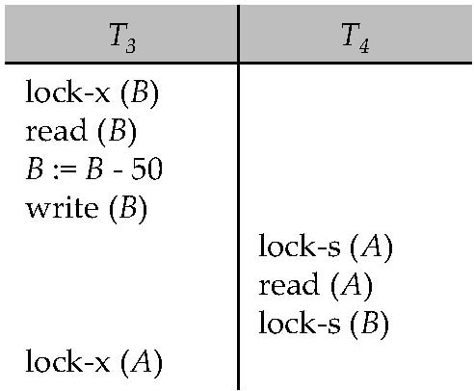
Deadlocks
Consider the partial schedule
Neither T₃ nor T₄ can make progress — executing lock-S(B) causes T₄ to wait for T₃ to release its lock on B, while executing lock-X(A) causes T₃ to wait for T₄ to release its lock on A.
Such a situation is called a deadlock.
To handle a deadlock one of T₃ or T₄ must be rolled back and its locks released.

Slide 52
Deadlocks (Cont.)
Two-phase locking does not ensure freedom from deadlocks.
In addition to deadlocks, there is a possibility of starvation.
Starvation occurs if the concurrency control manager is badly designed. For example:
A transaction may be waiting for an X-lock on an item, while a sequence of other transactions request and are granted an S-lock on the same item.
The same transaction is repeatedly rolled back due to deadlocks.
Concurrency control manager can be designed to prevent starvation.

Slide 53
Deadlocks (Cont.)
The potential for deadlock exists in most locking protocols. Deadlocks are a necessary evil.
When a deadlock occurs there is a possibility of cascading roll-backs.
Cascading roll-back is possible under two-phase locking. To avoid this, follow a modified protocol called strict two-phase locking -- a transaction must hold all its exclusive locks till it commits/aborts.
Rigorous two-phase locking is even stricter. Here, all locks are held till commit/abort. In this protocol transactions can be serialized in the order in which they commit.

Slide 54
Implementation of Locking[Locking Mechanism]
A lock manager can be implemented as a separate process to which transactions send lock and unlock requests
The lock manager replies to a lock request by sending a lock grant messages (or a message asking the transaction to roll back, in case of a deadlock)
The requesting transaction waits until its request is answered
The lock manager maintains a data-structure called a lock table to record granted locks and pending requests
The lock table is usually implemented as an in-memory hash table indexed on the name of the data item being locked

Slide 55
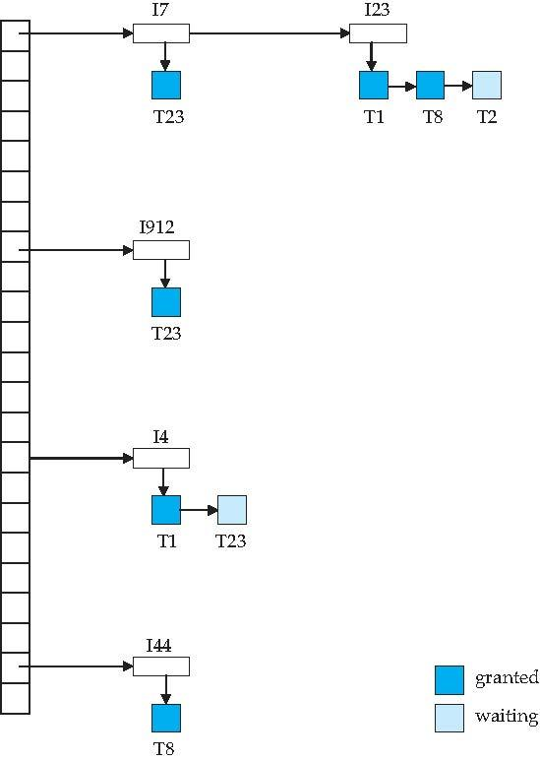
Lock Table
Dark blue rectangles indicate granted locks; light blue indicate waiting requests
Lock table also records the type of lock granted or requested
New request is added to the end of the queue of requests for the data item, and granted if it is compatible with all earlier locks
Unlock requests result in the request being deleted, and later requests are checked to see if they can now be granted
If transaction aborts, all waiting or granted requests of the transaction are deleted
lock manager may keep a list of locks held by each transaction, to implement this efficiently

Slide 56
Deadlock Handling
System is deadlocked if there is a set of transactions such that every transaction in the set is waiting for another transaction in the set.
Deadlock prevention protocols ensure that the system will never enter into a deadlock state. Some prevention strategies :
Require that each transaction locks all its data items before it begins execution (predeclaration).
Impose partial ordering of all data items and require that a transaction can lock data items only in the order specified by the partial order.

Slide 57
More Deadlock Prevention Strategies
Following schemes use transaction timestamps for the sake of deadlock prevention alone.
wait-die scheme — non-preemptive
older transaction may wait for younger one to release data item. (older means smaller timestamp) Younger transactions never Younger transactions never wait for older ones; they are rolled back instead.
a transaction may die several times before acquiring needed data item
wound-wait scheme — preemptive
older transaction wounds (forces rollback) of younger transaction instead of waiting for it. Younger transactions may wait for older ones.
may be fewer rollbacks than wait-die scheme.

Slide 58
Deadlock prevention (Cont.)
Both in wait-die and in wound-wait schemes, a rolled back transactions is restarted with its original timestamp. Older transactions thus have precedence over newer ones, and starvation is hence avoided.
Timeout-Based Schemes:
a transaction waits for a lock only for a specified amount of time. If the lock has not been granted within that time, the transaction is rolled back and restarted,
Thus, deadlocks are not possible
simple to implement; but starvation is possible. Also difficult to determine good value of the timeout interval.

Slide 59
Deadlock Detection
Deadlocks can be described as a wait-for graph, which consists of a pair G = (V,E),
V is a set of vertices (all the transactions in the system)
E is a set of edges; each element is an ordered pair T_{i} →T_{j}.
If T_{i} → T_{j} is in E, then there is a directed edge from T_{i} to T_{j}, implying that T_{i} is waiting for T_{j} to release a data item.
When T_{i} requests a data item currently being held by T_{j}, then the edge T_{i} → T_{j} is inserted in the wait-for graph. This edge is removed only when T_{j} is no longer holding a data item needed by T_{i}.
The system is in a deadlock state if and only if the wait-for graph has a cycle. Must invoke a deadlock-detection algorithm periodically to look for cycles.

Slide 60
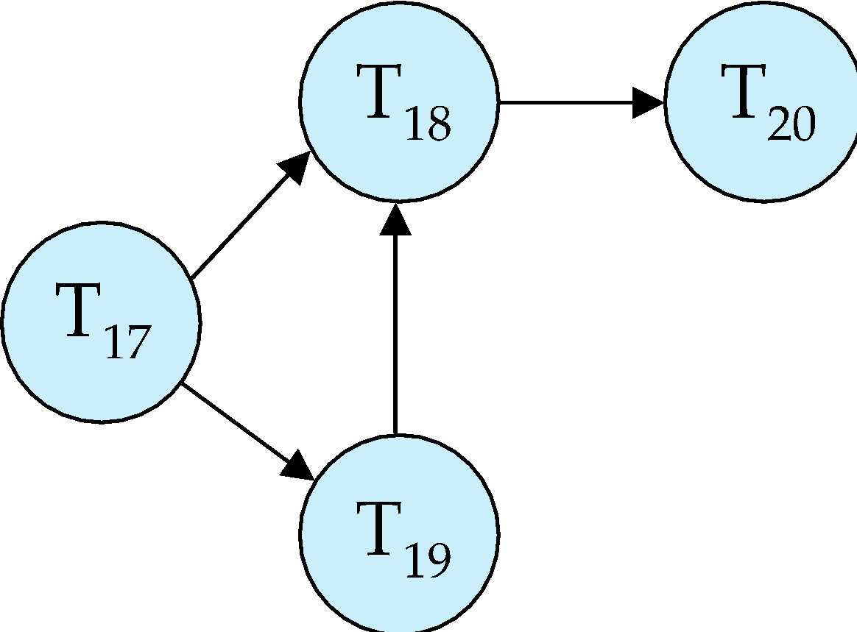
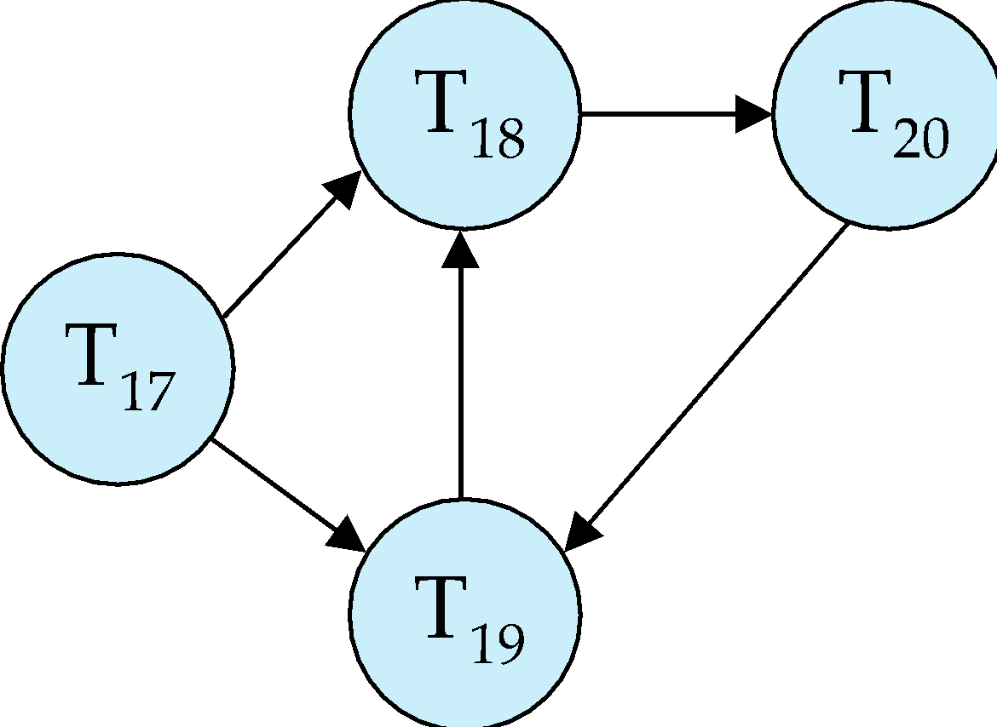
Deadlock Detection (Cont.)
Wait-for graph without a cycle
Wait-for graph with a cycle

Slide 61
Deadlock Recovery
When deadlock is detected :
Some transaction will have to rolled back (made a victim) to break deadlock. Select that transaction as victim that will incur minimum cost.
Rollback -- determine how far to roll back transaction
Total rollback: Abort the transaction and then restart it.
More effective to roll back transaction only as far as necessary to break deadlock.
Starvation happens if same transaction is always chosen as victim. Include the number of rollbacks in the cost factor to avoid starvation

Slide 62
ISOLATION:
In database systems, isolation determines how transaction integrity is visible to other users and systems.
A lower isolation level increases the ability of many users to access the same data at the same time, but increases the number of concurrency effects (such as dirty reads or lost updates) users might encounter. Conversely, a higher isolation level reduces the types of concurrency effects that users may encounter, but requires more system resources and increases the chances that one transaction will block another.

Slide 63
Isolation levels:
The isolation levels defined by the ANSI/ISO SQL standard are listed as follows:
Serializable
This is the highest isolation level.
With a lock-based concurrency control DBMS implementation, serializability requires read and write locks (acquired on selected data) to be released at the end of the transaction. Also range-locks must be acquired when a SELECT query uses a ranged WHERE clause, especially to avoid the phantom reads phenomenon.
When using non-lock based concurrency control, no locks are acquired; however, if the system detects a write collision among several concurrent transactions, only one of them is allowed to commit
Repeatable reads:
In this isolation level, a lock-based concurrency control DBMS implementation keeps read and write locks (acquired on selected data) until the end of the transaction. However, range-locks are not managed, so phantom reads can occur.
Write skew is possible at this isolation level in some systems. Write skew is a phenomenon where two writes are allowed to the same column(s) in a table by two different writers (who have previously read the columns they are updating), resulting in the column having data that is a mix of the two transactions

Slide 64
Read committed:
In this isolation level, a lock-based concurrency control DBMS implementation keeps write locks (acquired on selected data) until the end of the transaction, but read locks are released as soon as the SELECT operation is performed (so the non-repeatable reads phenomenon can occur in this isolation level). As in the previous level, range-locks are not managed.
Putting it in simpler words, read committed is an isolation level that guarantees that any data read is committed at the moment it is read. It simply restricts the reader from seeing any intermediate, uncommitted, 'dirty' read. It makes no promise whatsoever that if the transaction re-issues the read, it will find the same data; data is free to change after it is read.
Read uncommitted:
This is the lowest isolation level. In this level, dirty reads are allowed, so one transaction may see not-yet-committed changes made by other transactions.
Default isolation level:
The default isolation level of different DBMS's varies quite widely. Most databases that feature transactions allow the user to set any isolation level. Some DBMS's also require additional syntax when performing a SELECT statement to acquire locks (e.g. SELECT ... FOR UPDATE to acquire exclusive write locks on accessed rows).

Slide 65
Recovery System

Slide 66
Chapter 16: Recovery System
Failure Classification
Storage Structure
Recovery and Atomicity
Log-Based Recovery
Remote Backup Systems

Slide 67
Failure Classification
Transaction failure :
Logical errors: transaction cannot complete due to some internal error condition
System errors: the database system must terminate an active transaction due to an error condition (e.g., deadlock)
System crash: a power failure or other hardware or software failure causes the system to crash.
Fail-stop assumption: non-volatile storage contents are assumed to not be corrupted by system crash
Database systems have numerous integrity checks to prevent corruption of disk data
Disk failure: a head crash or similar disk failure destroys all or part of disk storage
Destruction is assumed to be detectable: disk drives use checksums to detect failures

Slide 68
Recovery Algorithms
Consider transaction T_{i} that transfers $50 from account A to account B
Two updates: subtract 50 from A and add 50 to B
Transaction T_{i} requires updates to A and B to be output to the database.
A failure may occur after one of these modifications have been made but before both of them are made.
Modifying the database without ensuring that the transaction will commit may leave the database in an inconsistent state
Not modifying the database may result in lost updates if failure occurs just after transaction commits
Recovery algorithms have two parts
Actions taken during normal transaction processing to ensure enough information exists to recover from failures
Actions taken after a failure to recover the database contents to a state that ensures atomicity, consistency and durability

Slide 69
Storage Structure
Volatile storage:
does not survive system crashes
examples: main memory, cache memory
Nonvolatile storage:
survives system crashes
examples: disk, tape, flash memory, non-volatile (battery backed up) RAM
but may still fail, losing data
Stable storage:
a mythical form of storage that survives all failures
approximated by maintaining multiple copies on distinct nonvolatile media
See book for more details on how to implement stable storage

Slide 70
Stable-Storage Implementation
Maintain multiple copies of each block on separate disks
copies can be at remote sites to protect against disasters such as fire or flooding.
Failure during data transfer can still result in inconsistent copies: Block transfer can result in
Successful completion
Partial failure: destination block has incorrect information
Total failure: destination block was never updated
Protecting storage media from failure during data transfer (one solution):
Execute output operation as follows (assuming two copies of each block):
Write the information onto the first physical block.
When the first write successfully completes, write the same information onto the second physical block.
The output is completed only after the second write successfully completes.
Notes:
‹#›

Slide 71
Stable-Storage Implementation (Cont.)
Protecting storage media from failure during data transfer (cont.):
Copies of a block may differ due to failure during output operation. To recover from failure:
First find inconsistent blocks:
Expensive solution: Compare the two copies of every disk block.
Better solution:
Record in-progress disk writes on non-volatile storage (Non-volatile RAM or special area of disk).
Use this information during recovery to find blocks that may be inconsistent, and only compare copies of these.
Used in hardware RAID systems
If either copy of an inconsistent block is detected to have an error (bad checksum), overwrite it by the other copy. If both have no error, but are different, overwrite the second block by the first block.
Notes:
‹#›

Slide 72
Data Access
Physical blocks are those blocks residing on the disk.
Buffer blocks are the blocks residing temporarily in main memory.
Block movements between disk and main memory are initiated through the following two operations:
input(B) transfers the physical block B to main memory.
output(B) transfers the buffer block B to the disk, and replaces the appropriate physical block there.
We assume, for simplicity, that each data item fits in, and is stored inside, a single block.

Slide 73
Example of Data Access
buffer
Buffer Block A
input(A)
X
A
Buffer Block B
Y
B
output(B)
read(X)
write(Y)
x₂
x₁
y₁
work area
of T₁
work area
of T₂
memory
disk

Slide 74
Data Access (Cont.)
Each transaction T_{i} has its private work-area in which local copies of all data items accessed and updated by it are kept.
T_{i}'s local copy of a data item X is called x_{i}.
Transferring data items between system buffer blocks and its private work-area done by:
read(X) assigns the value of data item X to the local variable x_{i}.
write(X) assigns the value of local variable x_{i} to data item {X} in the buffer block.
Note: output(B_{X}) need not immediately follow write(X). System can perform the output operation when it deems fit.
Transactions
Must perform read(X) before accessing X for the first time (subsequent reads can be from local copy)
write(X) can be executed at any time before the transaction commits

Slide 75
Recovery and Atomicity
To ensure atomicity despite failures, we first output information describing the modifications to stable storage without modifying the database itself.
We study log-based recovery mechanisms in detail
We first present key concepts
And then present the actual recovery algorithm
Less used alternative: shadow-copy and shadow-paging (brief details in book)
shadow-copy

Slide 76
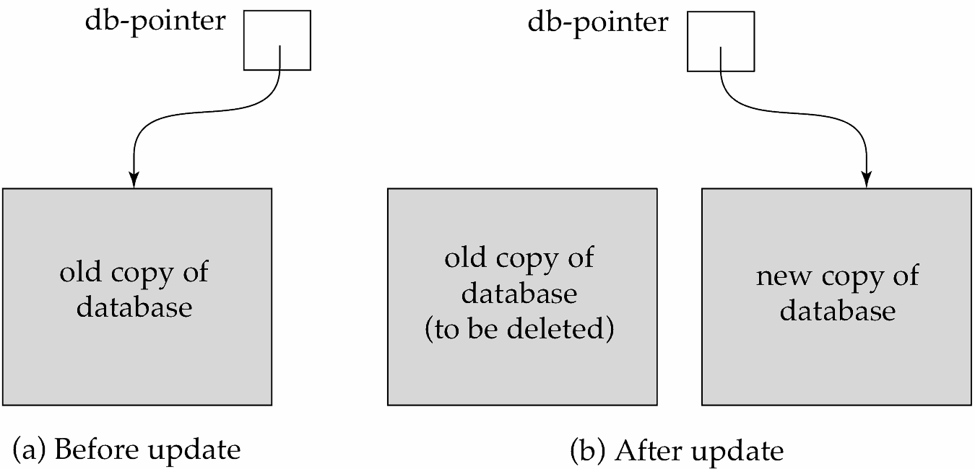
DIAGRAMATIC REPRESENTATION

Slide 77
Log-Based Recovery
A log is kept on stable storage.
The log is a sequence of log records, and maintains a record of update activities on the database.
When transaction T_{i} starts, it registers itself by writing a <T_{i} start>log record
Before T_{i} executes write(X), a log record <T_{i}, X, V₁, V₂> is written, where V₁ is the value of X before the write (the old value), and V₂ is the value to be written to X (the new value).
When T_{i} finishes it last statement, the log record <T_{i} commit> is written.
Two approaches using logs
Deferred database modification
Immediate database modification

Slide 78
Immediate Database Modification
The immediate-modification scheme allows updates of an uncommitted transaction to be made to the buffer, or the disk itself, before the transaction commits
Update log record must be written before database item is written
We assume that the log record is output directly to stable storage
(Will see later that how to postpone log record output to some extent)
Output of updated blocks to stable storage can take place at any time before or after transaction commit
Order in which blocks are output can be different from the order in which they are written.
The deferred-modification scheme performs updates to buffer/disk only at the time of transaction commit
Simplifies some aspects of recovery
But has overhead of storing local copy

Slide 79
Transaction Commit
A transaction is said to have committed when its commit log record is output to stable storage
all previous log records of the transaction must have been output already
Writes performed by a transaction may still be in the buffer when the transaction commits, and may be output later

Slide 80
Immediate Database Modification Example
Log Write Output
<T₀ start>
<T₀, A, 1000, 950>
<T_{o}, B, 2000, 2050
A = 950
B = 2050
<T₀ commit>
<T₁ start>
<T₁, C, 700, 600>
C = 600
B_{B} , B_{C}
<T₁ commit>
B_{A}
Note: B_{X} denotes block containing X.
B_{C} output before T₁ commits
B_{A} output after T₀ commits

Slide 81
Checkpoints
Redoing/undoing all transactions recorded in the log can be very slow
processing the entire log is time-consuming if the system has run for a long time
we might unnecessarily redo transactions which have already output their updates to the database.
Streamline recovery procedure by periodically performing checkpointing
Output all log records currently residing in main memory onto stable storage.
Output all modified buffer blocks to the disk.
Write a log record < checkpoint L> onto stable storage where L is a list of all transactions active at the time of checkpoint.
All updates are stopped while doing checkpointing

Slide 82
Checkpoints (Cont.)
During recovery we need to consider only the most recent transaction T_{i} that started before the checkpoint, and transactions that started after T_{i}.
Scan backwards from end of log to find the most recent <checkpoint L> record
Only transactions that are in L or started after the checkpoint need to be redone or undone
Transactions that committed or aborted before the checkpoint already have all their updates output to stable storage.
Some earlier part of the log may be needed for undo operations
Continue scanning backwards till a record <T_{i} start> is found for every transaction T_{i} in L.
Parts of log prior to earliest <T_{i} start> record above are not needed for recovery, and can be erased whenever desired.

Slide 83
Example of Checkpoints
T_{c}
T_{f}
T₁ can be ignored (updates already output to disk due to checkpoint)
T₂ and T₃ redone.
T₄ undone
T₁
T₂
T₃
T₄
checkpoint
system failure

Slide 84
Recovery Algorithm
So far: we covered key concepts
Now: we present the components of the basic recovery algorithm
Later: we present extensions to allow more concurrency

Slide 85
Recovery Algorithm
Logging (during normal operation):
<T_{i} start> at transaction start
<T_{i}, X_{j}, V₁, V₂> for each update, and
<T_{i} commit> at transaction end
Transaction rollback (during normal operation)
Let T_{i} be the transaction to be rolled back
Scan log backwards from the end, and for each log record of T_{i} of the form <T_{i}, X_{j}, V₁, V₂>
perform the undo by writing V₁ to X_{j},
write a log record <T_{i} , X_{j}, V₁>
such log records are called compensation log records
Once the record <T_{i} start> is found stop the scan and write the log record <T_{i} abort>

Slide 86
Recovery Algorithm (Cont.)
Recovery from failure: Two phases
Redo phase: replay updates of all transactions, whether they committed, aborted, or are incomplete
Undo phase: undo all incomplete transactions
Redo phase:
Find last <checkpoint L> record, and set undo-list to L.
Scan forward from above <checkpoint L> record
Whenever a record <T_{i}, X_{j}, V₁, V₂> or <T_{i}, X_{j}, V₂> is found, redo it by writing V₂ to X_{j}
Whenever a log record <T_{i} start> is found, add T_{i} to undo-list
Whenever a log record <T_{i} commit> or <T_{i} abort> is found, remove T_{i} from undo-list

Slide 87
Recovery Algorithm (Cont.)
Undo phase:
Scan log backwards from end
Whenever a log record <T_{i}, X_{j}, V₁, V₂> is found where T_{i} is in undo-list perform same actions as for transaction rollback:
perform undo by writing V₁ to X_{j}.
write a log record <T_{i} , X_{j}, V₁>
Whenever a log record <T_{i} start> is found where T_{i} is in undo-list,
Write a log record <T_{i} abort>
Remove T_{i} from undo-list
Stop when undo-list is empty
i.e. <T_{i} start> has been found for every transaction in undo-list
After undo phase completes, normal transaction processing can commence

Slide 88
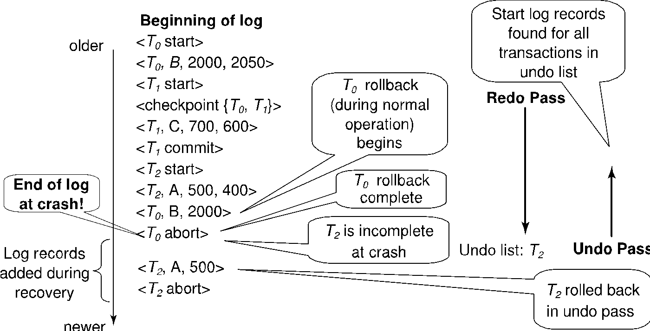
Example of Recovery

Slide 89
Log Record Buffering
Log record buffering: log records are buffered in main memory, instead of of being output directly to stable storage.
Log records are output to stable storage when a block of log records in the buffer is full, or a log force operation is executed.
Log force is performed to commit a transaction by forcing all its log records (including the commit record) to stable storage.
Several log records can thus be output using a single output operation, reducing the I/O cost.

Slide 90
Log Record Buffering (Cont.)
The rules below must be followed if log records are buffered:
Log records are output to stable storage in the order in which they are created.
Transaction T_{i} enters the commit state only when the log record <T_{i} commit> has been output to stable storage.
Before a block of data in main memory is output to the database, all log records pertaining to data in that block must have been output to stable storage.
This rule is called the write-ahead logging or WAL rule
Strictly speaking WAL only requires undo information to be output

